Slide 1





BIKE SALES OPTIMIZATION
PROJECT
PREDICTIVE ANALYSIS
Page 1

Slide 2

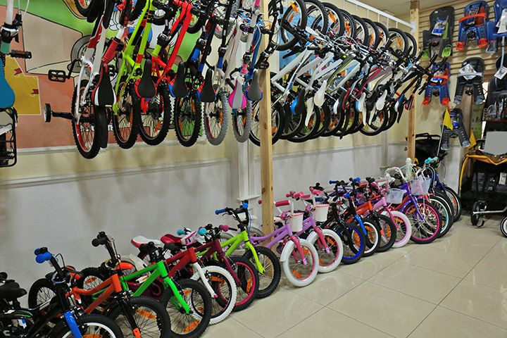



Introduction
The bicycle industry is highly competitive, requiring businesses to leverage data-driven insights to understand market trends and customer behavior, optimize pricing, manage inventory, and enhance marketing efforts. Machine learning algorithms can predict bike sales, identify key sales drivers, and provide actionable recommendations for improving business strategies.
Page 2

Slide 3



TABLE OF CONTENT
01
Aims /Objectives
04
Data Cleaning
02
05
Data Distribution & Analysis
Project Overview
03
Data Synopsis
06
Machine Learning
Page 3

Slide 4



AIMS AND OBJECTIVES
01
Analyze the gender demographics of the dataset.
Understand seasonal trends
Identify the model type that generated the most profit.
Determine the country with the highest purchase volume.
To develop a robust model for pricing strategy optimization
02
03
04
05
Page 4

Slide 5

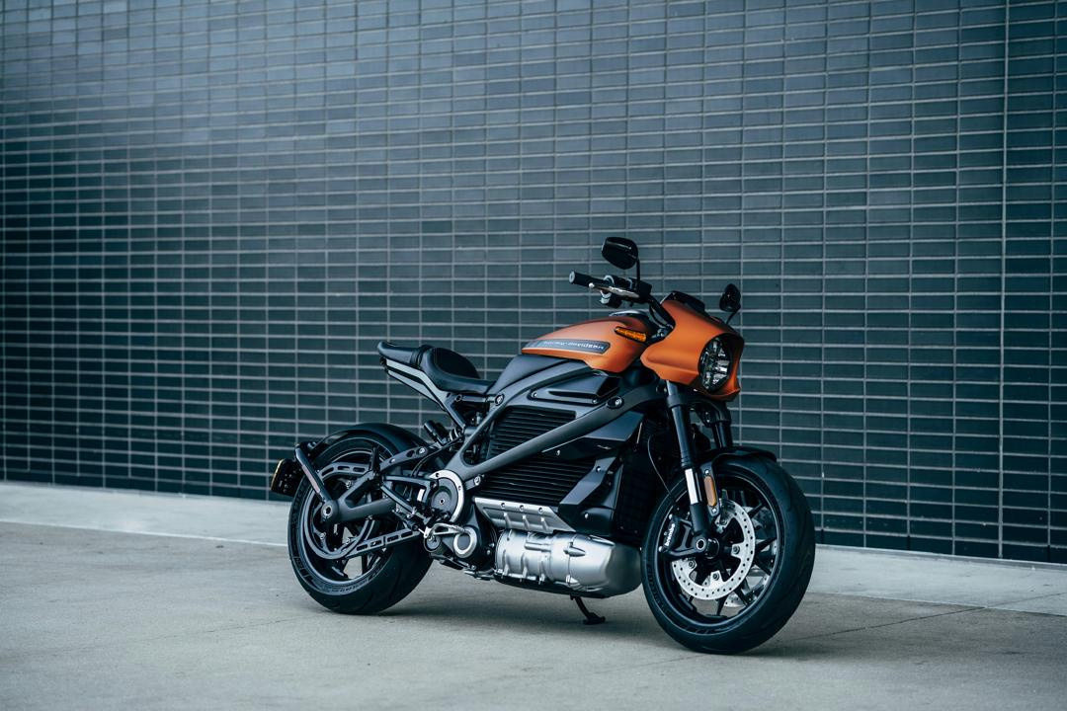
PROJECT OVERVIEW
DATA PROFILLING
Analyze the data's structure, format, and content.
DATA QUALITY ASSESSMENT
Identify potential issues like missing values, outliers, inconsistencies, and duplicates.
Page 5

Slide 6


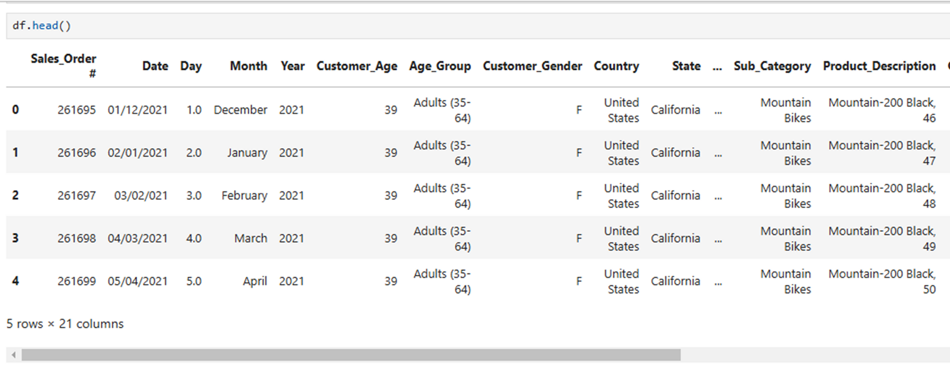
DATA SYNOPSIS
The dimension of this dataset is 214 rows and 19 columns.
Page 6

Slide 7



DATA CLEANING
Handling Missing Values
Removing Duplicates
Changing Data Types
Splitting Columns
Page 7

Slide 8

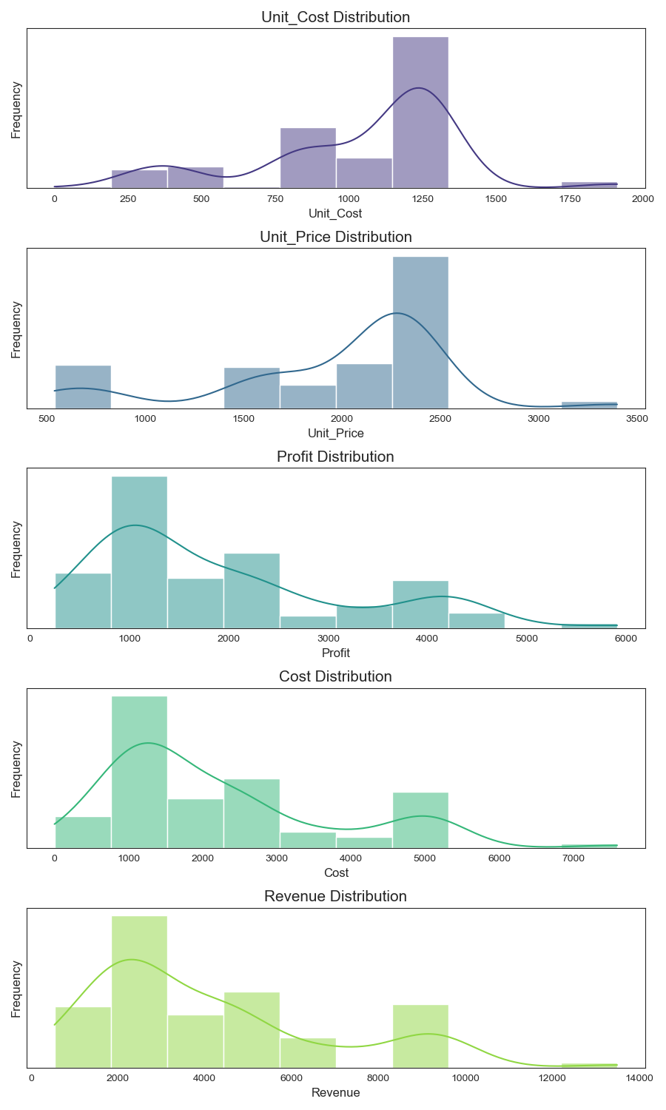
DATA DISTRIBUTION
Page 8

Slide 9




DATA ANALYSIS
Page 9

Slide 10
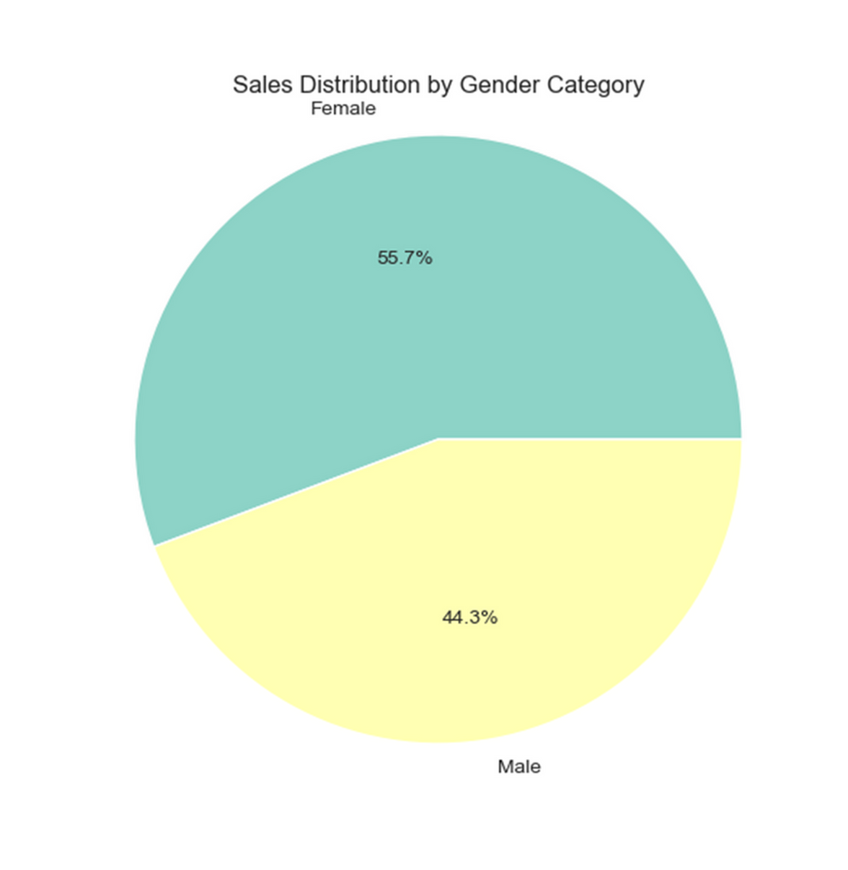



Which customer demographics contribute most to sales and revenue?
DATA INSIGHTS
44.3%
55.7%
Page 10

Slide 11
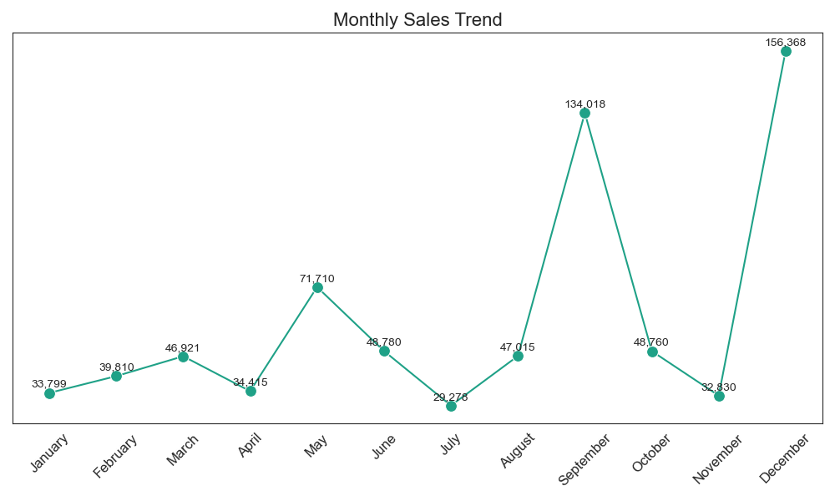
DATA INSIGHTS
Understand seasonal trends; Identifying seasonal patterns in revenue.
Page 11

Slide 12
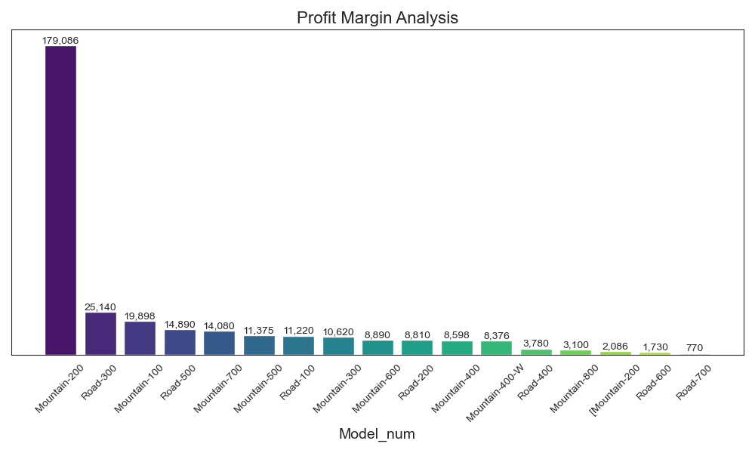
DATA INSIGHTS
Which model type generated the most profit?
Which Model type generated the most profit?
Page 12

Slide 13
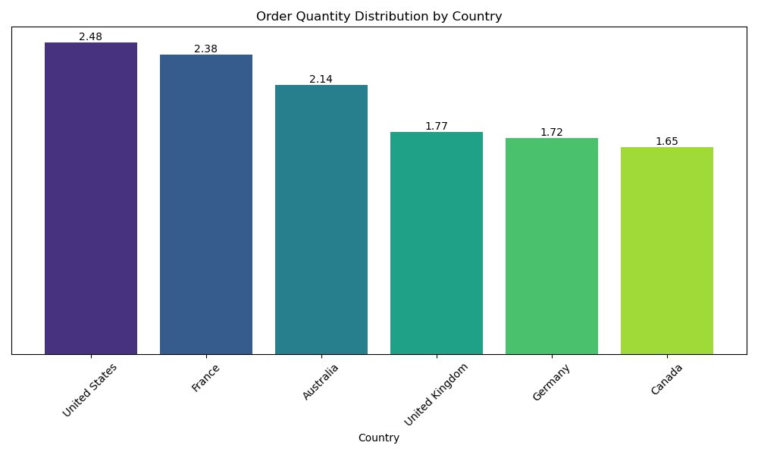
DATA INSIGHTS
Which country made the most purchase?
Page 13

Slide 14






RECOMMENDATION
Customer Satisfaction
Revenue Growth
•Analyze seasonal patterns to optimize marketing and inventory during peak months
•Promote the Mountain-200 model, our top-selling product.
•Leverage this insight to offer personalized product recommendations to female customers, enhancing their satisfaction and loyalty
Business Success
* Analyze products with higher unit costs, prices, and profits: Identify the factors contributing to their success and explore ways to replicate them across other products.
Page 14

Slide 15





MACHINE LEARNING
Page 15

Slide 16

MACHINE LEARNING
Goals
Develop a machine learning model to accurately predict bike prices based on key features.
Page 16

Slide 17












MACHINE LEARNING
Performance tuning
Model selection
Prediction
Data Preprocessing
Model training
Evaluation
Conclusion
Page 17

Slide 18


MACHINE LEARNING
Categorical Encoding
Scaling
Split data into train and test
Support Vector Regression (SVR)
Data Preprocessing/ Feature engineering
Model selection
Model Training
Trained with 80% of the data set.
Features:
Target: Unit Price
Page 18

Slide 19
MACHINE LEARNING
Experient with different models to find best fit.
Experient with different models to find best fit.
Performance tuning
Evaluation
Prediction
Test the model to predict a known price.
Page 19

Slide 20
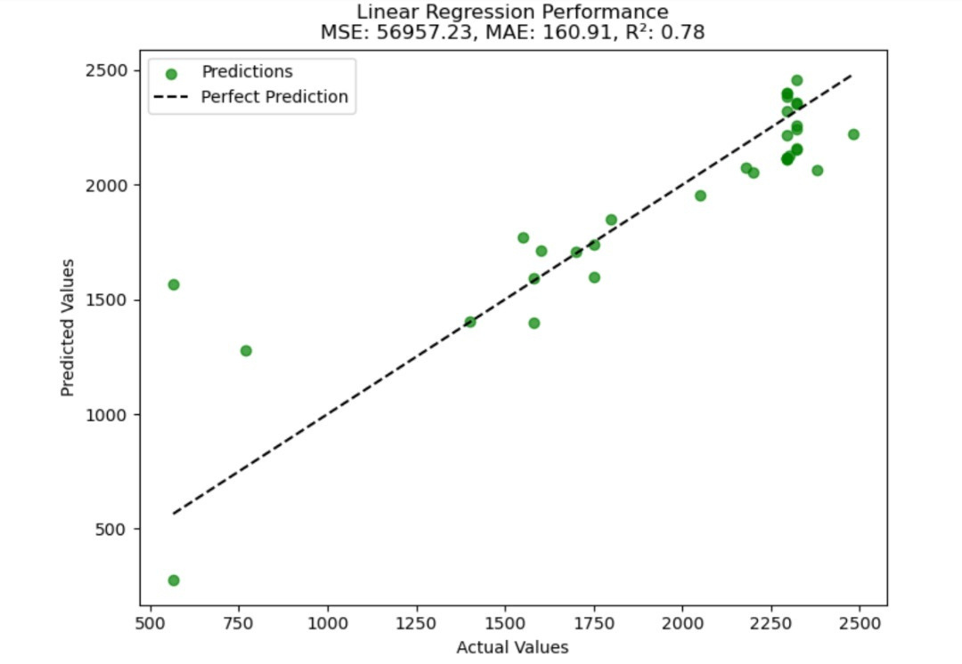

MACHINE LEARNING
Linear Regression
Ridge Regression
Page 20

Slide 21
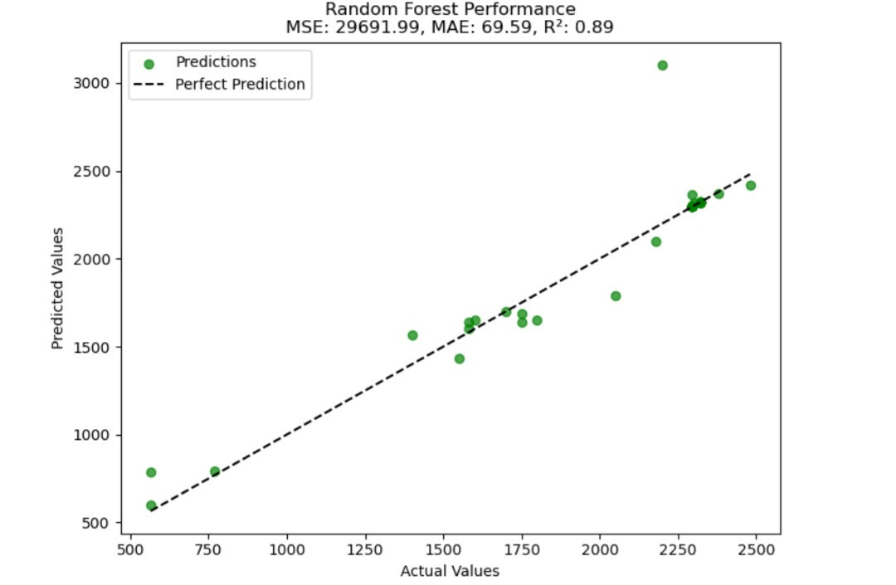
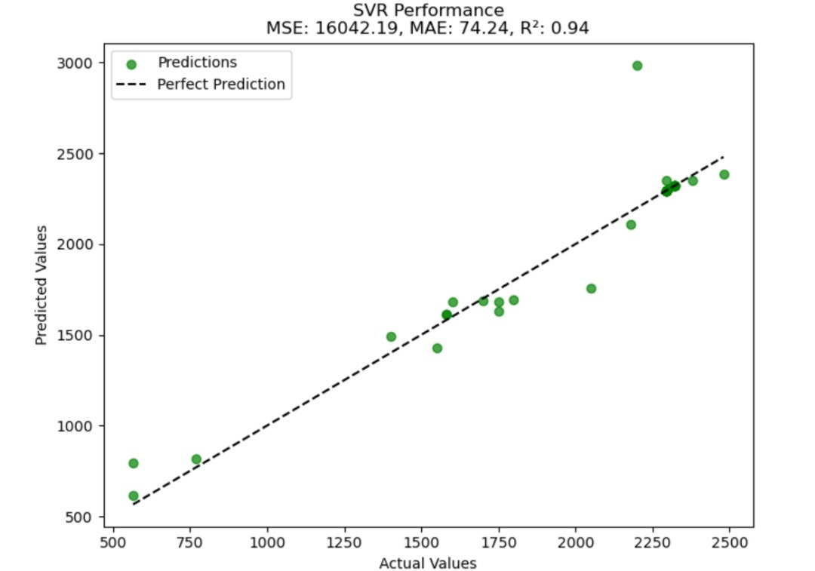
MACHINE LEARNING
Random Forest
Support Vector Regression
Page 21

Slide 22



MACHINE LEARNING
CONCLUSION
Our machine learning successfully predicts bike prices based on key features. This machine demonstrates the power of data driven decision making in the bike industry. By leveraging predictive analysis, businesses can optimize pricing strategies and drive revenue growth.
Model Prediction Score
Page 22

Slide 23
















Team Members
Micheal Asante
Yayra Joyce Osafo
Ghansah Abokomah
Emelia N.K. Quaye
Dannette K. Zotorvie
Joycelyn Otoo
Theophilus T. Felix
Page 23

Slide 24




THANK YOU
FOR YOUR NICE ATTENTION
Page 24

